Slide 1
Almost Mid-Semester Thoughts
3550, Fall 2020

Slide 2
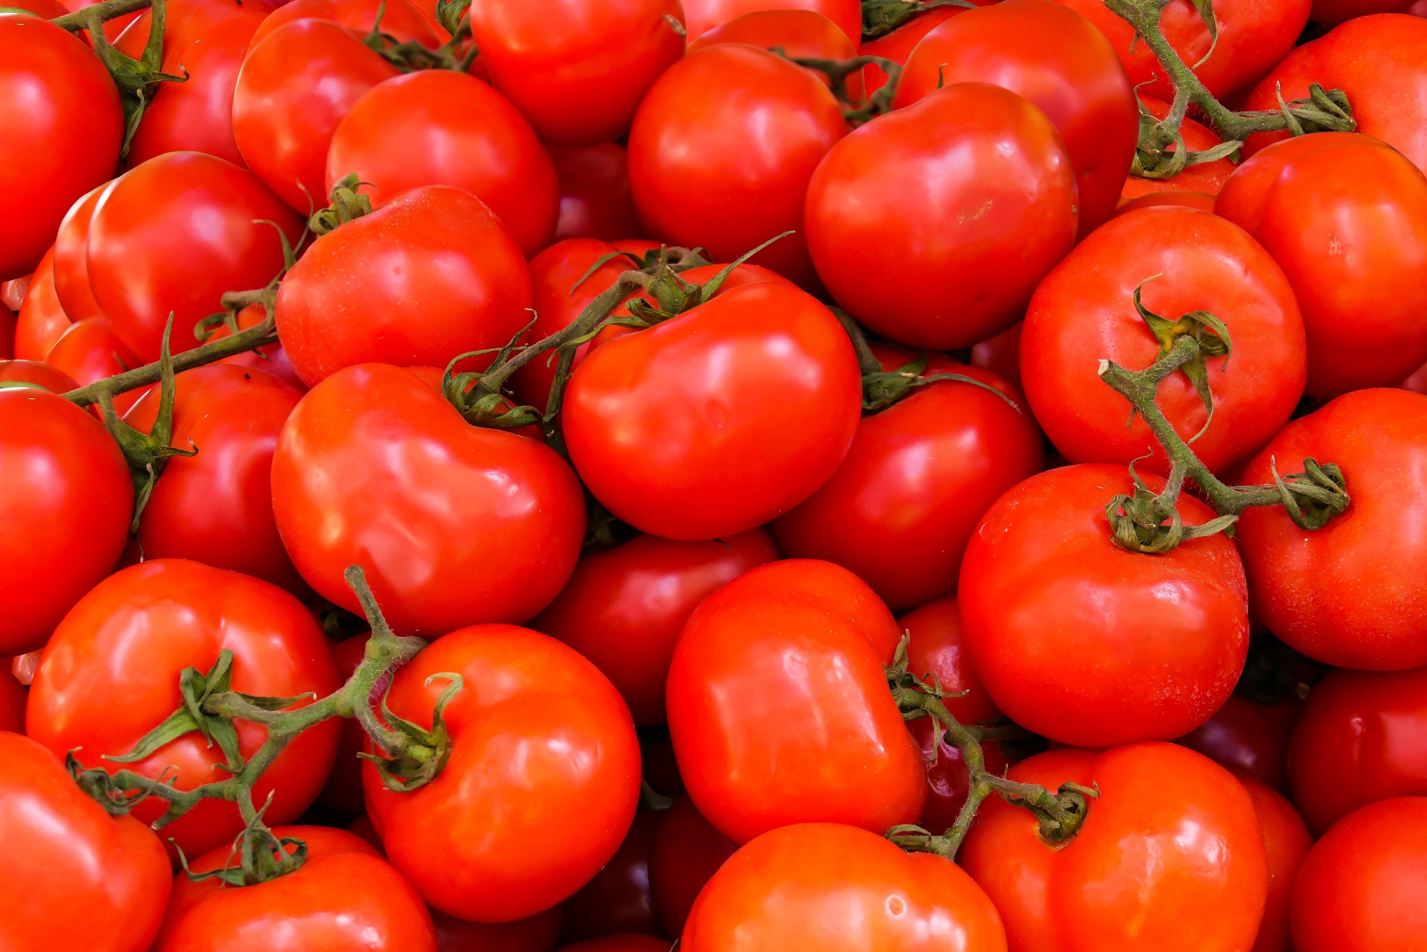

Slide 3
Networking

Slide 4
Networking – First Half
Upper
HTML
Threads
Processes
Java Server
Node Server
APIs
Page Synchronization
Transport
Network
Data Link
Physical

Slide 5
Networking – Second Half
Upper
Transport
Network
Data Link
Physical

